Slide 1
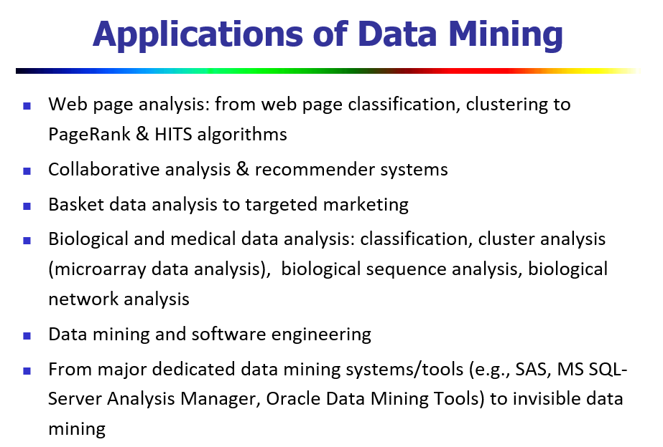
Introduction
Notes:
1.`Classification: Categorising pages into topics (e.g. news, sports, technology).
Clustering: Grouping similar web pages together without predefined categories.
PageRank & HITS algorithms: Ranking pages based on link structures for search engines like Google.
2. E-commerce: Suggesting products on Amazon.
Entertainment: Recommending movies on Netflix based on user preferences.
Uses collaborative filtering techniques to find user-item patterns.

Slide 2
Knowledge Discovery from Data (KDD) Process
Data mining plays an essential role in the knowledge discovery process
The KDD process
Data cleaning
Data integration
Data selection
Data transformation
Data mining
Pattern evaluation
Knowledge presentation

Slide 3
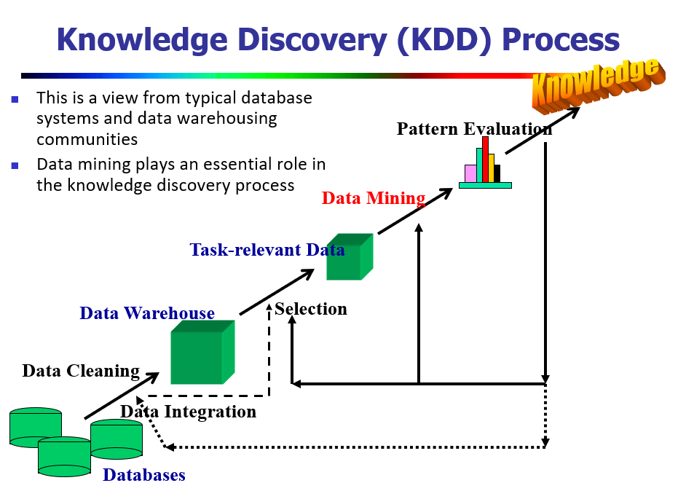
KDD Process
A data warehouse is a centralised repository that stores large volumes of data collected from multiple sources in an organised manner to support business analysis and decision-making.

Slide 4
knowledge discovery process
1.Data cleaning - to remove noise(irrelevant, random, outliers or meaningless data) and inconsistent data. Ex: Handling missing values, correcting typos, removing duplicates.
2. Data integration - where multiple data sources may be combined.
Ex: Merging different databases (e.g. sales + customer support data).
3. Data selection - where data relevant to the analysis task are retrieved from the database. Ex: Selecting only customer transaction data within the last year.
4. Data transformation - where data are transformed and consolidated into forms appropriate for mining by performing summary or aggregation operations.
Ex: Normalization (scaling data into a specific range), aggregation, encoding categorical variables.

Slide 5
5.Data mining - an essential process where intelligent methods are applied to extract data patterns.
Examples:
1.Classification (predicting categories)
2.Clustering (grouping similar data)
3.Association rule mining (finding item relationships)
6.Pattern evaluation - to identify the truly interesting patterns representing knowledge based on interestingness measures
Examples: Evaluating rules based on confidence, support, or statistical significance.
7.Knowledge presentation- where visualization and knowledge representation techniques are used to present mined knowledge to users.
Examples: Using graphs, charts, reports, dashboards, or visualisation tools.

Slide 6
Classification Vs Clustering
Aspect | Classification | Clustering
Type of learning | Supervised learning | Unsupervised learning
Definition | Assigning data items to predefined classes or categories based on training data. | Grouping similar data items into clusters without predefined labels.
Training data | Requires labelled data (each example has a known class). | Does not require labelled data.
Goal | Predict class labels for new data based on learnt patterns. | Discover hidden patterns or structures in data by grouping similar items.

Slide 7
Classification Vs Clustering
Examples | - Email spam detection (spam / not spam) - Disease diagnosis (diabetic / non-diabetic) - Image recognition (cat / dog / car) | - Customer segmentation (grouping similar customers) - Grouping news articles by topic - Market segmentation
Output | Model that can assign new unseen data to one of the known classes. | Groups or clusters, where each cluster contains similar items.
Algorithms used | Decision Trees, Naive Bayes, k-NN, SVM, Neural Networks. | K-Means, Hierarchical clustering, DBSCAN, Gaussian Mixture Models.
Example situation | You have a dataset of flowers with species labels and want to predict the species of a new flower. | You have customer purchasing data with no labels and want to group customers into segments based on buying behavior.

Slide 8
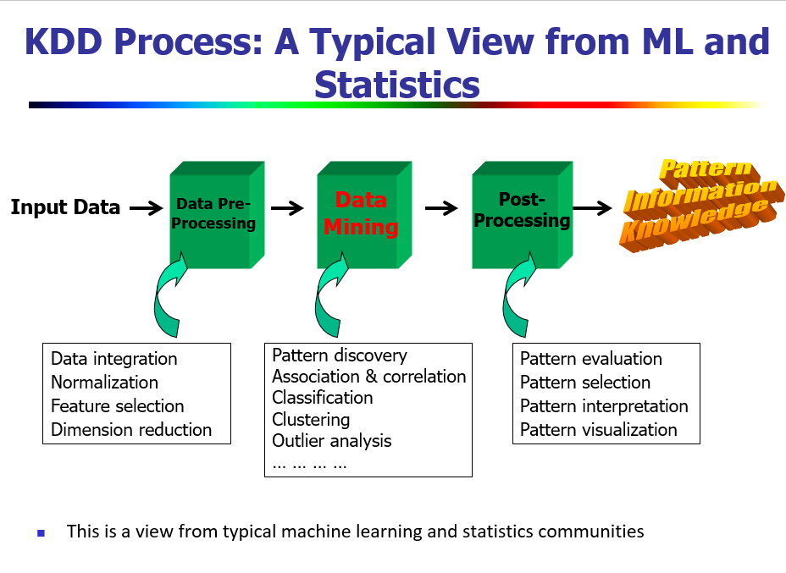
Feature Selection | Dimensionality Reduction
Notes:
Feature Selection Selecting a subset of relevant features (original variables) from the existing features.
Dimensionality Reduction Transforming data from high-dimensional space to a lower-dimensional space using mathematical techniques.

Slide 9
Chapter 1. Introduction
Why Data Mining?
What Is Data Mining?
What Kind of Data Can Be Mined?
What Kinds of Patterns Can Be Mined?
Which Technologies Are Used?
Which Kinds of Applications Are Targeted?
Major Issues in Data Mining
Summary

Slide 10
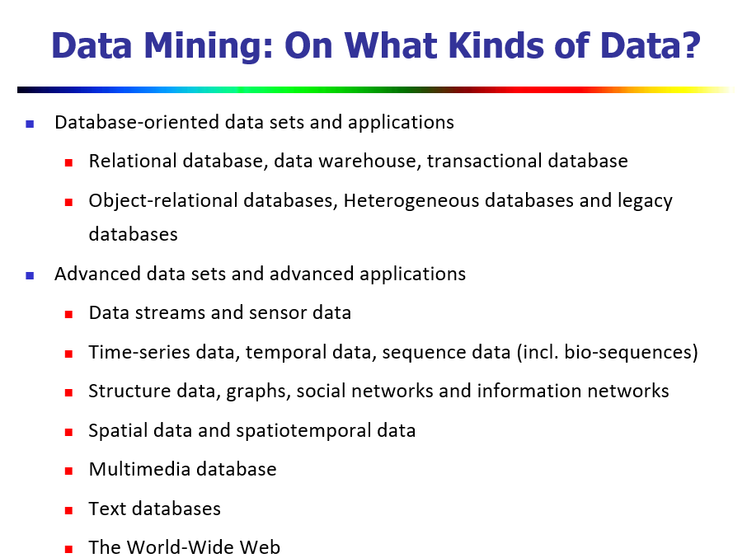
Introduction
Notes:
Data streams and sensor data:
Continuous data coming from sensors, IoT devices, or online streaming sources.
Example: Temperature sensors, ECG monitors.
Time-series data, temporal data, sequence data (including bio-sequences):
Data collected over time intervals.
Example: Stock prices, gene sequences.
Structured data, graphs, social networks, and information networks:
Data representing relationships or connections.
Example: Social network graphs (Facebook connections), citation networks.
Spatial data and spatiotemporal data:
Data with geographical or spatial information and time-based aspects.
Example: GPS data, weather tracking data.
Multimedia databases:
Contain images, audio, and video data.
Example: YouTube’s video database.
Text databases:
Collections of textual documents.
Example: News articles, research papers.
The World-Wide Web:
Web data mining extracts patterns from websites, user clicks, and web structures.

Slide 11
1.3 What Kinds of Data Can Be Mined?
Applied to any kind of data as long as the information is meaningful for targeted application.
Database Data:
🞑 DBMS – collection of interrelated data (database) and set of programs for manipulation
🞑 RDBMS – collection of tables (unique name)
  Table – set of attributes (columns/fields) and stores tuples (records/rows)
  Unique key –ER model
🞑 RDBMS – accessed by database queries (SQL)
  Query – relational operations such as join, selection & projection
🞑 RDBMS – to analyze the trends or data patterns

Slide 12
What Kinds of Data Can Be Mined?
Example: A relational database for AllElectronics. The company is described by the following relation tables: customer, item, employee, and branch.
customer
(cust ID, name, address, age, occupation, annual income, credit information, category, . . . )
(item ID, brand, category, type, price, place made, supplier, cost, . . . ) (empl ID, name, category, group, salary, commission, . . . )
(branch ID, name, address, . . . )
(trans ID, cust ID, empl ID, date, time, method paid, amount) (trans ID, item ID, qty)
(empl ID, branch ID)
item employee branch purchases items sold works at

Slide 13
What Kinds of Data Can Be Mined?
Data Warehouse:
A data warehouse is a repository of information collected from multiple sources, stored under a unified schema, and usually residing at a single site.
Data source in Chicago
Client
Clean Integrate Transform Load Refresh
Data source in New York
Data Warehouse
Query and analysis tools
Data source in Toronto
Client
Data source in Vancouver

Slide 14
What Kinds of Data Can Be Mined?
Transactional Data:
🞑 transactional database captures a transaction - a customer’s purchase, a flight booking, or a user’s clicks on a web page.
🞑 A transaction typically includes a unique transaction identity number (trans ID) and a list of the items making up the transaction, such as the items purchased in the transaction.
🞑 A transactional database may have additional tables, which contain other information related to the transactions, such as item description, information about the salesperson or the branch, and so on.
Example: A transactional database for AllElectronics. Transactions can be stored in a table, with one record per transaction
Nested relational structures: list_of_item_IDs consists of set of items
Query: Which items sold well together?
trans ID | list of item IDs
T100 | I1, I3, I8, I16
T200 | I2, I8
... | ...

Slide 15
Chapter 1. Introduction
Why Data Mining?
What Is Data Mining?
What Kind of Data Can Be Mined?
What Kinds of Patterns Can Be Mined?
Which Technologies Are Used?
Which Kinds of Applications Are Targeted?
Major Issues in Data Mining
Summary

Slide 16
1.4 What Kinds of Patterns Can Be Mined?
Concept/Class Description: Characterization and Discrimination
Mining Frequent Patterns, Associations and Correlations
Classification and Regression
Cluster Analysis
Outlier Analysis

Slide 17
1.4.1 Concept/Class Description: Characterization and Discrimination
Data can be associated with classes or concepts
Class/ Concept Description
🞑 E.g.
classes of items – computers, printers, …
concepts of customers – bigSpenders, budgetSpenders, …
🞑 Descriptions can be derived via data characterization(data summarization), Data discrimination or both
Data characterization – summarizing the general characteristics of a target class of data.
  E.g. summarizing the characteristics of customers who spend more than $1,000 a year at AllElectronics.
  Result can be a general profile of the customers, such as 40 – 50 years old, employed, have excellent credit ratings.
Data discrimination – comparing the target class with one or a set of comparative classes
  E.g. Compare the general features of software products whole sales increase by 10% in the last year with those whose sales decrease by 30% during the same period
Or both of the above

Slide 18
1.4.2 Mining Frequent Patterns, Associations and Correlations
Frequent patterns are patterns that occur frequently in data
Types:
🞑Frequent itemset: a set of items that frequently appear together in a transactional data set (e.g. charger cable and adapter)
🞑 Frequent subsequence / sequential patterns: a pattern that customers tend to purchase product A, followed by a purchase of product B
(Ex: Mobile -->Charger -->Earphones)
🞑 Frequent substructure: A substructure can refer to different structural forms (e.g., graphs, trees, or lattices(Lattices represent all possible combinations of items and their frequency counts) that may be combined with itemsets or subsequences.

Slide 19
Mining Frequent Patterns, Associations and Correlations
🞑 Association Analysis: find frequent patterns
E.g. AllElectronics Store which items are frequently purchased:
buys(X, “computer”) => buys(X, “software”) [support = 1%, confidence = 50%]
(if a customer buys a computer, there is a 50% chance that he/she will buy software. 1% of all of the transactions under analysis showed that computer and software are purchased together. )
This association rule involves a single attribute or predicate (i.e., buys) that repeats.
Association rules that contain a single predicate are referred to as single- dimensional association rules.
Dropping the predicate notation, the rule can be written simply as
computer ⇒ software [1%, 50%]

Slide 20
Mining Frequent Patterns, Associations and Correlations
AllElectronics: Purchases
  EX: age(X , “20..29”) ∧ income(X , “40K..49K”) ⇒ buys(X , “laptop”) [support = 2%, confidence = 60%].
Rule denotes 2% are 20 to 29 years old with an income of $40,000 to $49,000 and have purchased a laptop (computer) at AllElectronics.
There is a 60% probability that a customer in this age and income group will purchase a laptop.
This is an association involving more than one attribute or predicate (i.e., age, income, and buys) - multidimensional association rule.
Typically, association rules are discarded as uninteresting if they do not satisfy both a minimum support threshold and a minimum confidence threshold.

Slide 21
1.4.3 Classification and Regression for predictive Analysis
Classification: The process of finding a model that describes and distinguishes the data classes or concepts.
🞑 The derived model is based on the analysis of a set of training data (data objects whose class label is known).
🞑 The model can be represented in classification (IF-THEN) rules, decision trees, neural networks, etc.
age(X, “youth”) AND income(X, “high”)
age(X, “youth”) AND income(X, “low”) age(X, “middle_aged”)
age(X, “senior”)
class(X, “A”)
class(X, “B”)
class(X, “C”)
class(X, “C”)
If-then
A neural network ,when used for classification, is typically a collection of neuron-like processing units with weighted connections between the units.
Decision Tree
Neural Networks
age?
youth
middle_aged, senior
age
class C
income
f₃
f₆
class A
f₁
income?
f₄
f₇
class B
f₂
high
low
f₅
f₈
class C
class A
class B

Slide 22
Classification and Regression for Predictive Analysis
Regression: predict missing or unavailable numerical data values rather than discrete(It cannot take every value within a range – only specific, countable values) class labels.
classification predicts categorical (discrete, unordered labels, regression models continuous-valued functions.
Prediction: both numeric prediction and class label prediction
Regression analysis is a statistical methodology that is most often used for numeric prediction. Regression also encompasses the identification of distribution trends based on the available data.
Classification and regression may need to be preceded by relevance analysis, which attempts to identify attributes that are significantly relevant to the classification and regression process.
🞑 Such attributes will be selected for the classification and regression process. Other attributes, which are irrelevant, can then be excluded from consideration.

Slide 23
Classification and Regression for Predictive Analysis
Classification Example: AllElectronics - classify a large set of items in the store, based on three kinds of responses to a sales campaign: good response, mild response and no response.
Derive a model for each of these three classes based on the descriptive features of the items, such as price, brand, place made, type, and category.
🞑The resulting classification should maximally distinguish each class from the others, presenting an organized picture of the data set.
Regression Example: AllElectronics - Predict the amount of revenue that each item will generate during an upcoming sale, based on the previous sales data.
🞑 This is an example of regression analysis because the regression model constructed will predict a continuous function (or ordered value.)

Slide 24
Classification Vs Regression
Aspect | Classification | Regression
Definition | Predicts categorical/discrete labels or classes. | Predicts continuous numerical values.
Output type | Class labels (e.g., spam or not spam, disease or no disease). | Real-valued outputs (e.g., house price = $350,000, temperature = 29.5°C).
Examples | - Email spam detection (spam/not spam) - Disease prediction (disease present/absent) - Image recognition (cat, dog, car) | Predicting house prices Predicting blood glucose level - Predicting age based on facial features
Nature of target variable | Categorical (nominal or ordinal) | Continuous (real-valued)

Slide 25
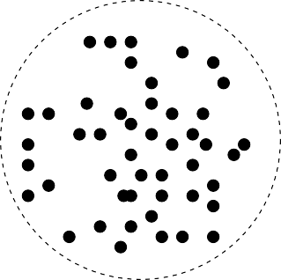

1.4.4 Cluster Analysis
Unlike classification and regression, which analyze class-labeled (training) data sets,
clustering analyzes data objects without consulting class labels.
In many cases, class- labeled data may simply not exist at the beginning.
Clustering can be used to generate class labels for a group of data.
The objects are clustered or grouped based on the principle of maximizing the intraclass similarity and minimizing the interclass similarity.

Slide 26
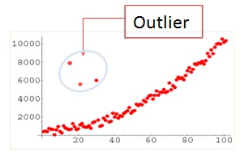
1.4.5 Outlier Analysis
A data set may contain objects that do not comply with the general behavior or model of the data. These data objects are outliers.
Many data mining methods discard outliers as noise or exceptions. However, in some applications (e.g., fraud detection) the rare events can be more interesting than the more regularly occurring ones. The analysis of outlier data is referred to as outlier analysis or anomaly mining.
Example: Fraudulent Activity Credit Card Usage

Slide 27
1.4.6 Are All Patterns Interesting?
A data mining system has the potential to generate thousands or even millions of patterns, or rules.
Are all of the patterns interesting? – No
A pattern is interesting if it is
🞑 easily understood by humans
🞑 valid on new or test data with some degree of certainty,
🞑 potentially useful
🞑 novel
🞑 validates some hypothesis(trial solution of a problem) that a user seeks to confirm
An interesting measure represents knowledge !

Slide 28
Are All Patterns Interesting?
Objective measures
🞑 statistics and structures of patterns, e.g., support, confidence, etc. (Rules that do not satisfy a threshold are considered uninteresting.)
🞑 accuracy and coverage - percentage of data that are correctly classified by a rule.
Coverage is similar to support, in that it tells us the percentage of data to which a rule applies
🞑 Although objective measures help identify interesting patterns, they are often insufficient unless combined with subjective measures that reflect a particular user’s needs and interests.
🞑 For example, patterns describing the characteristics of customers who shop frequently at AllElectronics should be interesting to the marketing manager, but may be of little interest to other analysts studying the same database for patterns on employee performance.

Slide 29
Are All Patterns Interesting?
Subjective measures
🞑 Reflect the needs and interests of a particular user.
  E.g. A marketing manager is only interested in characteristics of customers who shop frequently.
🞑 Based on user’s belief in the data.
  e.g., Patterns are interesting if they are unexpected, or can be used for strategic planning, etc
Objective and subjective measures need to be combined.
Find all the interesting patterns: Completeness
🞑 Unrealistic and inefficient
🞑 User-provided constraints and interestingness measures should be used
Search for only interesting patterns: An optimization problem
🞑 Highly desirable
🞑 No need to search through the generated patterns to identify truly interesting ones.
🞑 Measures can be used to rank the discovered patterns according their interestingness

Slide 30
Chapter 1. Introduction
Why Data Mining?
What Is Data Mining?
A Multi-Dimensional View of Data Mining
What Kind of Data Can Be Mined?
What Kinds of Patterns Can Be Mined?
Which Technologies Are Used?
Which Kinds of Applications Are Targeted?
Major Issues in Data Mining
Summary

Slide 31
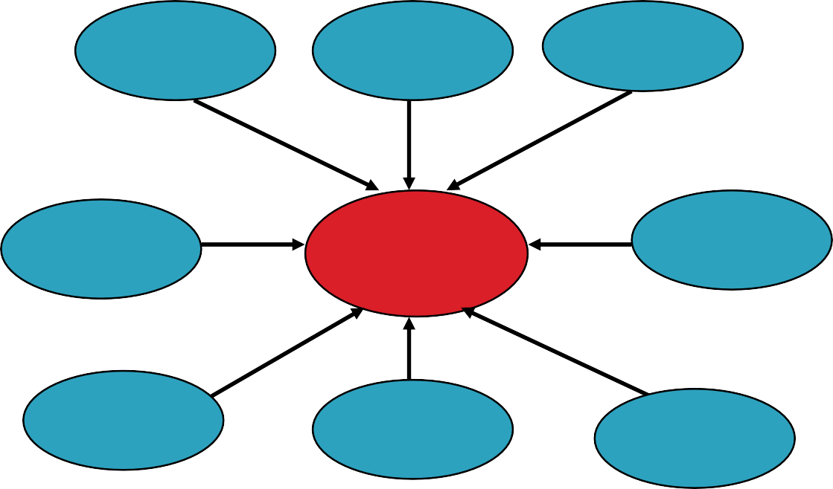
1.5 Which Technologies Are Used?
As a highly application-driven domain, data mining has incorporated many techniques from other domains such as:
🞑 statistics
🞑 machine learning
🞑 pattern recognition
🞑 database and data warehouse
🞑 information retrieval
🞑 Visualization
🞑 Algorithms
Machine Learning
Pattern Recognition
Statistics
Applications
Data Mining
Visualization
Algorithm
Database Technology
High-Performance Computing
🞑 high- performance computing, and many application domains
The interdisciplinary nature of data mining research and development contributes significantly to the success of data mining and its extensive applications.

Slide 32
1.5.1 Statistics
Statistics - studies the collection, analysis, interpretation or explanation, and presentation of data.
A statistical model is a set of mathematical functions that describe the behaviour of the objects in a target class in terms of random variables and their associated probability distributions.
Statistical models are widely used to model data and data classes.
For example, in data mining tasks like data characterization and classification, statistical models of target classes can be built. In other words, such statistical models can be the outcome of a data mining task.
Alternatively, data mining tasks can be built on top of statistical models.
For example, we can use statistics to model noise and missing data values. Then, when mining patterns in a large data set, the data mining process can use the model to help identify and handle noisy or missing values in the data.

Slide 33
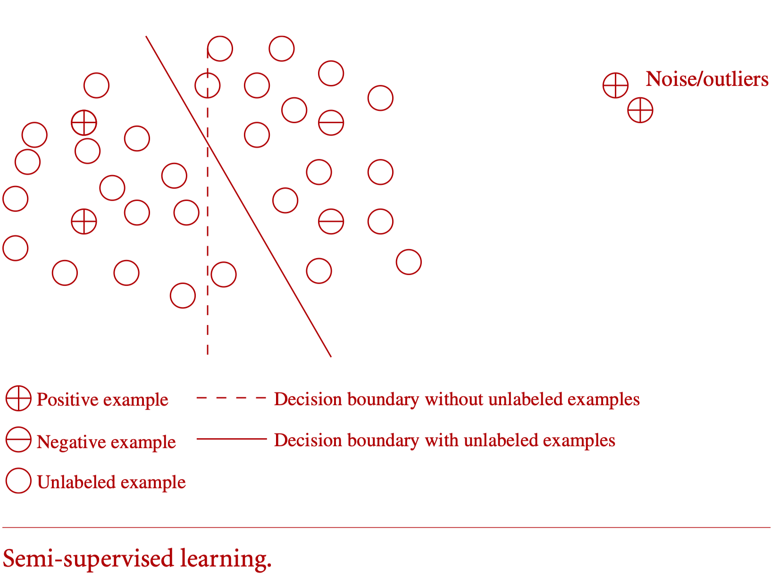
1.5.2 Machine Learning
Machine learning investigates how computers can learn (or improve their performance) based on data.
classic problems in machine learning that are highly related to data mining.
🞑 Supervised learning - Classification
🞑 Unsupervised learning - Clustering
🞑 Semi-supervised learning - both
🞑 Active learning - users in learning process
(Learns from a small initial labeled dataset
and actively selects additional data points to
be labeled by querying an oracle.)
Supervised Learning(dashed Line)
UnSupervised Learning(Solid Line)

Slide 34
Machine Learning Types
Type | Definition | Key Features | Examples
Supervised Learning | Learning using labelled data; model learns a mapping from input to output. | - Requires input-output pairs for training.- Used for prediction or classification.- Learns from past data with known outputs. | - Classification: Spam detection, disease prediction.- Regression: House price prediction, sales forecasting.
Unsupervised Learning | Learning using unlabelled data; model identifies patterns or structures. | - No predefined outputs.- Used for clustering, association, dimensionality reduction.- Finds hidden structures in data. | - Clustering: Customer segmentation.- Association: Market basket analysis (Apriori).- Dimensionality reduction: PCA.

Slide 35
Machine Learning Types
Type | Definition | Key Features | Examples
Semi-supervised Learning | Learning from small labelled + large unlabelled data. | - Combines supervised and unsupervised.- Improves learning accuracy with less labelled data cost. | - Text classification with few labelled samples.- Image recognition with limited annotations.
Reinforcement Learning | Learning through trial and error interaction with environment to maximize rewards. | - Agent, environment, reward, policy.- No labelled input-output pairs.- Learns optimal actions by receiving feedback (reward/punishment). | - Robotics path planning.- Game playing (Chess, Go).- Self-driving cars (control decisions).

Slide 36
1.5.3 Database Systems and Data Warehouses
Database systems
🞑 focuses on the creation, maintenance, and use of databases for organizations and end-users.
🞑 Follows - highly recognized principles in data models, query languages, query processing and optimization methods, data storage, and indexing and accessing methods.
Data warehouse
🞑 integrates data originating from multiple sources and various timeframes.
🞑 consolidates data in multidimensional space to form partially materialized data cubes.
🞑 facilitates not only OLAP in multidimensional databases but also promotes multidimensional data mining

Slide 37
OLAP (Online Analytical Processing)
1. Definition
OLAP is a category of data processing that enables fast analysis of multidimensional data from a data warehouse or data mart. It is designed for complex queries and analytics, not transactional processing.
2. Key features
Multidimensional analysis: Data is viewed from multiple perspectives (dimensions) such as time, geography, product, etc.
Fast query performance: Pre-aggregated data cubes enable rapid computation for analytical queries.
Data cubes: Structures that organize data into multidimensional arrays, facilitating aggregation and slicing/dicing.

Slide 38
Operations of OLAP
Slice: Selecting a single dimension value to create a sub-cube.
Example: Sales data for 2023 only.
Dice: Selecting a sub-cube by specifying ranges for multiple dimensions.
Example: Sales data for products A and B in regions X and Y during Q1 and Q2.
Drill-down: Navigating from summary data to more detailed data.
Example: From yearly sales to monthly sales.
Roll-up: Aggregating detailed data into a summary.
Example: From daily sales to monthly sales.
Pivot (Rotate): Reorienting the multidimensional view to view data from different perspectives. Example: Switching rows and columns in reports.

Slide 39
1.5.4 Information Retrieval
33
Information Retrieval is a science of searching for documents or information in documents
Key Differences (vs. traditional database queries)
🞑 (1) the data under search are unstructured; and
🞑 (2) the queries are formed mainly by keywords
Types of Information Retrieval Models
(a) Language Model:
Treats a document as being generated by a probability density function over words.
Explanation:
  It assumes each document has its own language model (distribution of words).
  Similarity between documents can be computed based on the similarity of their language models.
  Example:
  If Document A and Document B have similar word distributions, they are considered similar.

Slide 40
(b) Topic Model:
Represents documents in terms of topics, where each topic is a probability distribution over vocabulary words.
Explanation:
Identifies latent (hidden) topics within a large collection of documents.
Each document is then described as a mixture of these topics.
Example:
Using Latent Dirichlet Allocation (LDA) to find topics like “sports”, “politics”, “technology” across news articles.

Slide 41

Chapter 1. Introduction
34
Why Data Mining?
What Is Data Mining?
A Multi-Dimensional View of Data Mining
What Kind of Data Can Be Mined?
What Kinds of Patterns Can Be Mined?
Which Technologies Are Used?
Which Kinds of Applications Are Targeted?
Major Issues in Data Mining
Summary

Slide 42
1.6 Which Kinds of Applications Are Targeted?
35
“Where there are data, there are data mining applications”
Many applications
To demonstrate the importance of applications as a major dimension in data mining research and development, discuss two highly successful and popular application examples of data mining:
🞑 business intelligence
🞑 search engines

Slide 43
1.6.1 Business Intelligence
36
Business intelligence (BI) technologies provide historical, current, and predictive views of business operations.
Examples include reporting, online analytical processing, business performance management, competitive intelligence, benchmarking, and predictive analytics.
“How important is business intelligence?”
Without data mining, many businesses may not be able to perform effective market analysis, compare customer feedback on similar products, discover the strengths and weaknesses of their competitors, retain highly valuable customers, and make smart business decisions.

Slide 44
Business Intelligence
37
Clearly, data mining is the core of business intelligence.
OLAP tools in business intelligence rely on data warehousing and multidimensional data mining.
Classification and prediction techniques are the core of predictive analytics in analyzing markets, supplies, and sales.
Moreover, clustering plays a central role in customer relationship management, which groups customers based on their similarities.
Using characterization mining techniques, we can better understand features of each customer group and develop customized customer reward programs.

Slide 45
1.6.2 Web Search Engines
38
A Web search engine is a specialized computer server that searches for information on the Web.
Various data mining techniques are used in all aspects of search engines:
🞑 crawling - deciding which pages should be crawled and the crawling frequencies
🞑 indexing - selecting pages to be indexed and deciding to which extent the index should be constructed
🞑 searching - deciding how pages should be ranked, which advertisements should be added, and how the search results can be personalized or made “context aware”
Search engines - grand challenges:
🞑 handle a huge and ever-growing amount of data
🞑 have to deal with online data
🞑 Responding to context-aware query
(Example: Searching “coffee shops” shows nearby shops based on user location.)

Slide 46
1.7 Major Issues in Data Mining
39
Major issues in data mining research:
🞑 mining methodology,
🞑 user interaction,
🞑 efficiency and scalability,
🞑 diversity of data types, and
🞑 data mining and society
Many of these issues have been addressed in recent data mining research and development to a certain extent and are now considered data mining requirements; others are still at the research stage.

Slide 47
1.7.1 Mining Methodology
40
Developing new data mining methodologies involves in the investigation of
🞑Mining various and new kinds of knowledge: data analysis and knowledge discovery tasks
🞑Mining knowledge in multidimensional space : Data Cube
🞑 Data mining—an interdisciplinary effort: integrating methods from other disciplines
🞑Boosting the power of discovery in a networked environment: a linked or interconnected environment
🞑Handling uncertainty, noise, or incompleteness of data: noise, errors, exceptions, or uncertainty, or are incomplete
🞑Pattern evaluation and pattern- or constraint-guided mining: interesting patterns

Slide 48
1.7.2 User Interaction
41
◻ Interesting areas of research include how to interact with a data mining system, how to incorporate a user’s background knowledge in mining, and how to visualize and comprehend data mining results.
Interactive mining:
🞑 The data mining process should be highly interactive. Thus, it is important to build flexible user interfaces and an exploratory mining environment, facilitating the user’s interaction with the system.
Incorporation of background knowledge:
🞑 Background knowledge, constraints, rules, and other information regarding the domain under study should be incorporated into the knowledge discovery process
Ad hoc data mining and data mining query languages:
🞑 high-level data mining query languages or other high-level flexible user interfaces will give users the freedom to define ad hoc data mining tasks.
Presentation and visualization of data mining results:
🞑 adopt expressive knowledge representations, user-friendly interfaces, and visualization techniques.

Slide 49
1.7.3 Efficiency and Scalability
42
Efficiency and scalability are always considered when comparing data mining algorithms.
As data amounts continue to multiply, these two factors are especially critical.
Efficiency and scalability:
🞑 running time of a data mining algorithm must be predictable, short, and acceptable by applications.
🞑 Efficiency, scalability, performance, optimization, and the ability to execute in real time are key criteria that drive the development of many new data mining algorithms.
Efficiency-Refers to how quickly and resource-effectively a data mining algorithm or system can process data.An efficient algorithm uses minimal CPU time, memory, and storage while performing tasks.
Scalability-Refers to the algorithm’s ability to handle increasing amounts of data without a significant drop in performance.
A scalable data mining system works well with:
  Large datasets (millions of records or more)
  High-dimensional data (many attributes/features)
  Distributed data sources

Slide 50
Parallel, distributed, and incremental mining algorithms:
🞑 First partition the data into “pieces.” Each piece is processed, in parallel, by searching for patterns.
🞑 The parallel processes may interact with one another. The patterns from each partition are eventually merged.
Parallel mining:
Data is divided into pieces (partitions).
Each piece is processed simultaneously by different processors or machines to search for patterns.
Advantage: Significantly reduces processing time by utilizing multiple processors.
Distributed mining:
Data is stored across multiple locations or systems.
Mining is performed at each site, and results are combined to get global patterns.
Advantage: Avoids data transfer overhead and ensures scalability for geographically distributed data.
Incremental mining:
Updates mining results without reprocessing entire data when new data arrives.
Efficient for dynamic and continuously growing datasets.

Slide 51
1.7.4 Diversity of Database Types
43
Handling complex types of data:
🞑 Diverse applications generate a wide spectrum of new data type
🞑 unrealistic to expect one data mining system to mine all kinds of data, given the diversity of data types and the different goals of data mining
Mining dynamic, networked, and global data repositories:
🞑 Multiple sources of data are connected by the Internet and various kinds of networks, forming gigantic, distributed, and heterogeneous global information systems and networks

Slide 52
1.7.5 Data Mining and Society
44
Social impacts of data mining:
🞑 With data mining penetrating our everyday lives, it is important to study the impact of data mining on society.
🞑 How can we use data mining technology to benefit society? How can we guard against its misuse?
  The improper disclosure or use of data and the potential violation of individual privacy and data protection rights are areas of concern that need to be addressed.
Privacy-preserving data mining:
🞑 Data mining will help scientific discovery, business management, economy recovery, and security protection (e.g., the real-time discovery of intruders and cyberattacks).
🞑 However, it poses the risk of disclosing an individual’s personal information.
🞑 Studies on privacy-preserving data publishing and data mining are ongoing.
🞑 The philosophy is to observe data sensitivity and preserve people’s privacy while performing successful data mining.

Slide 53
1.7.5 Data Mining and Society
45
Invisible data mining:
🞑 We cannot expect everyone in society to learn and master data mining techniques.
🞑 More and more systems should have data mining functions built within
🞑 Intelligent search engines and Internet-based stores perform such invisible data mining by incorporating data mining into their components to improve their functionality and performance.
🞑 For example, when purchasing items online, users may be unaware that the store is likely collecting data on the buying patterns of its customers, which may be used to recommend other items for purchase in the future.

Slide 54
Summary
46
Data mining: Discovering interesting patterns and knowledge from massive amount of data
A natural evolution of database technology, in great demand, with wide applications
A KDD process includes data cleaning, data integration, data selection, transformation, data mining, pattern evaluation, and knowledge presentation
Mining can be performed in a variety of data
Data mining functionalities: characterization, discrimination, classification, clustering, outlier and trend analysis, etc.
association,
Data mining technologies

